Slide 1
How to have conversations about climate change

Slide 2
Monday, we talking about the inequalities of climate change. Wednesday, we explored our personal observations of change, learned the power of storytelling, and using our own experiences in communication.

Slide 3
“One of the major things that's been holding us back from implementing all these solutions we have at our fingertips is people not being able to see that it's worth it”
Dr. Ayana Elizabeth Johnson

Slide 4
“One of the major things that's been holding us back from implementing all these solutions we have at our fingertips is people not being able to see that it's worth it”
Dr. Ayana Elizabeth Johnson
When I come to the end of my life, I want the scales to show that I prevented more carbon emissions than I caused. And there is no way to make that happen if I work only on myself. My offset plan is activism.
L.C. Stokes
Notes:
Katherine Hayhoe tells a story in her book Saving Us, while talking about changing water availability, a farmer in the crowd yells, “I’m not selling my truck, I need it!”

Slide 5
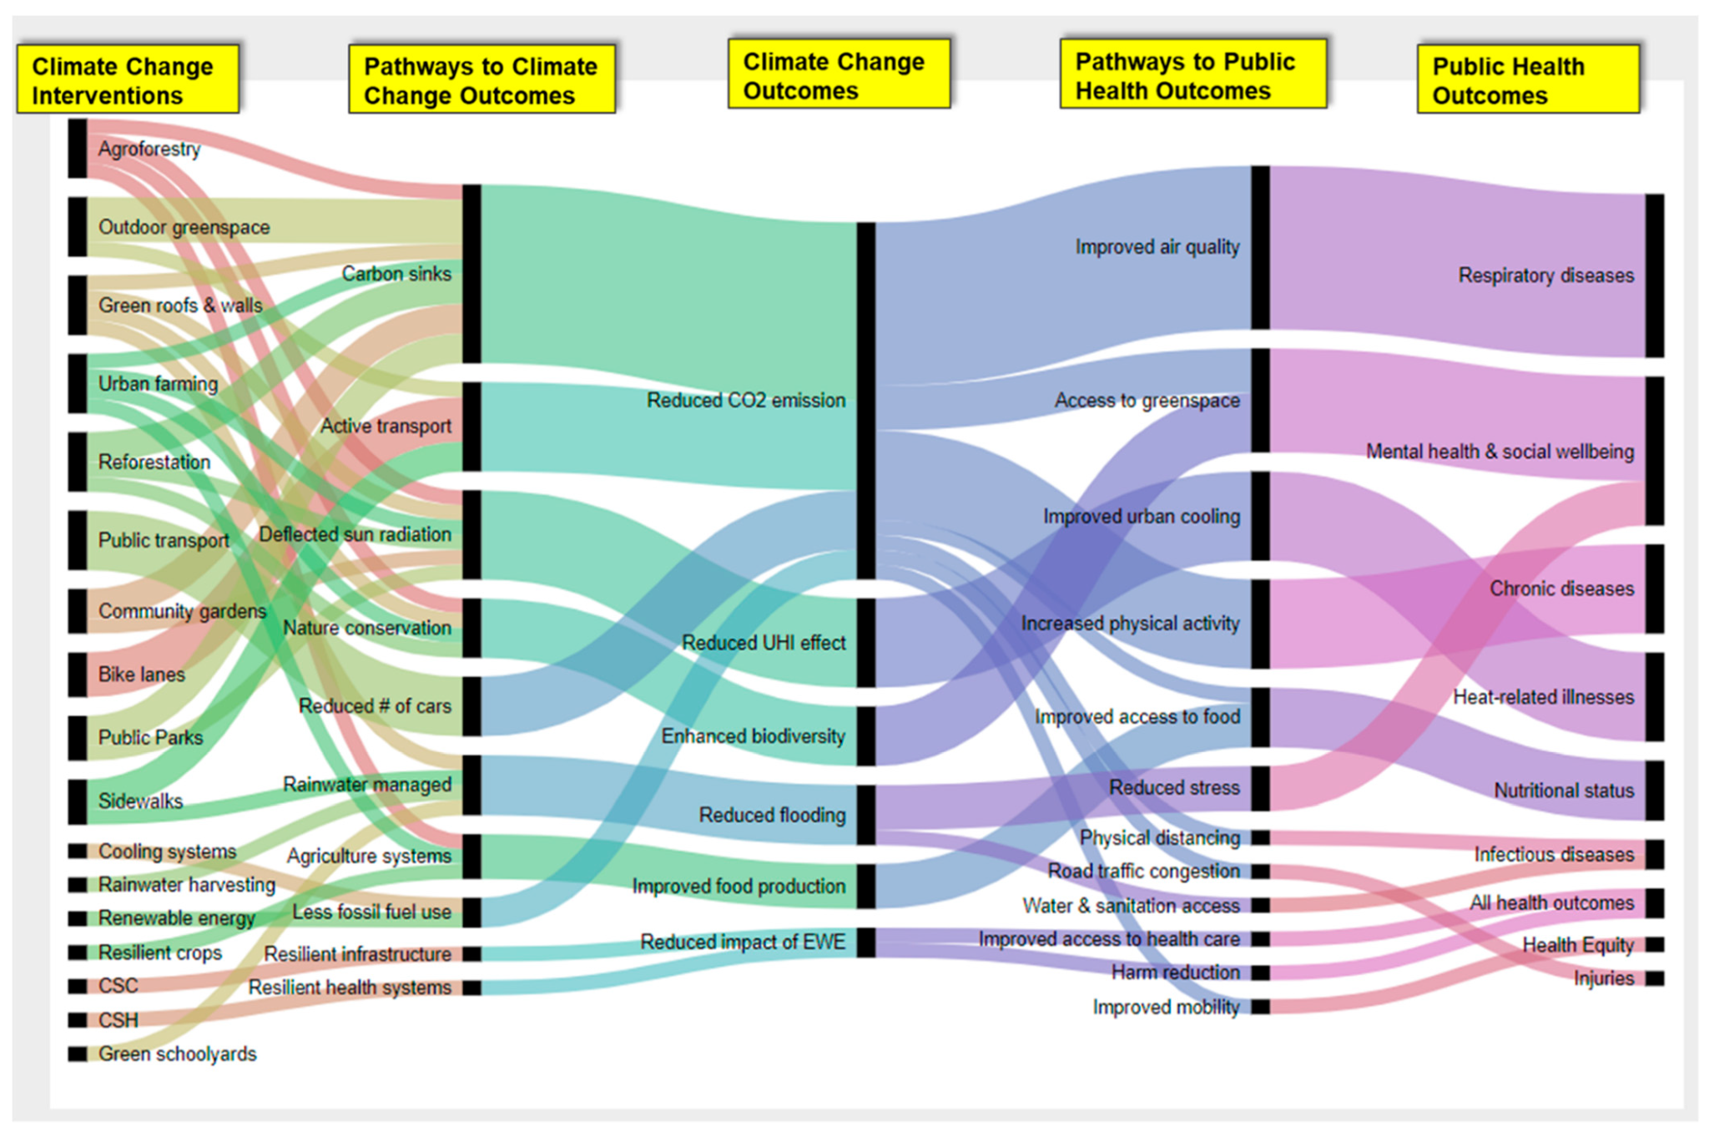
Bikomeye et al. (2021)

Slide 6
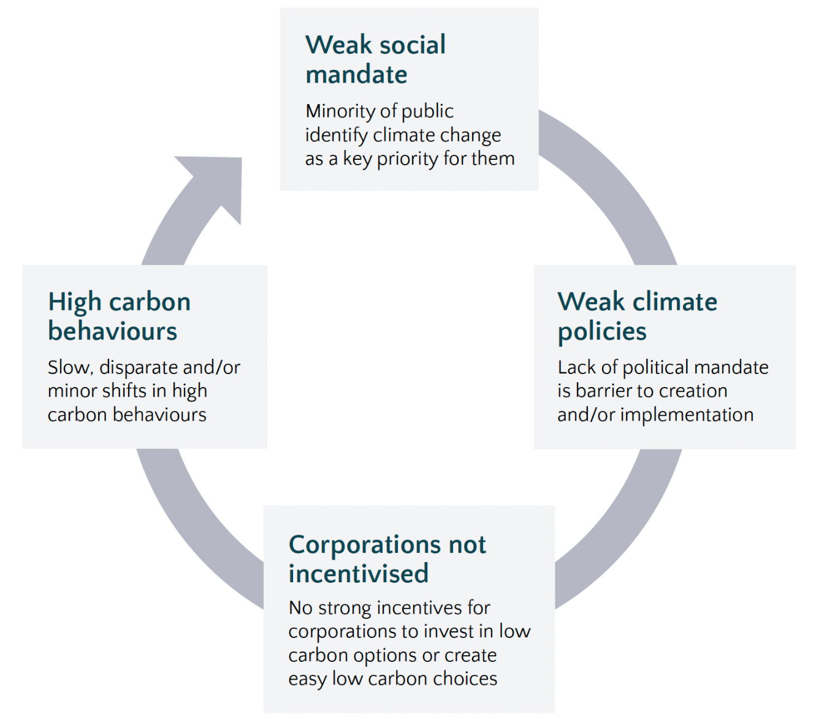
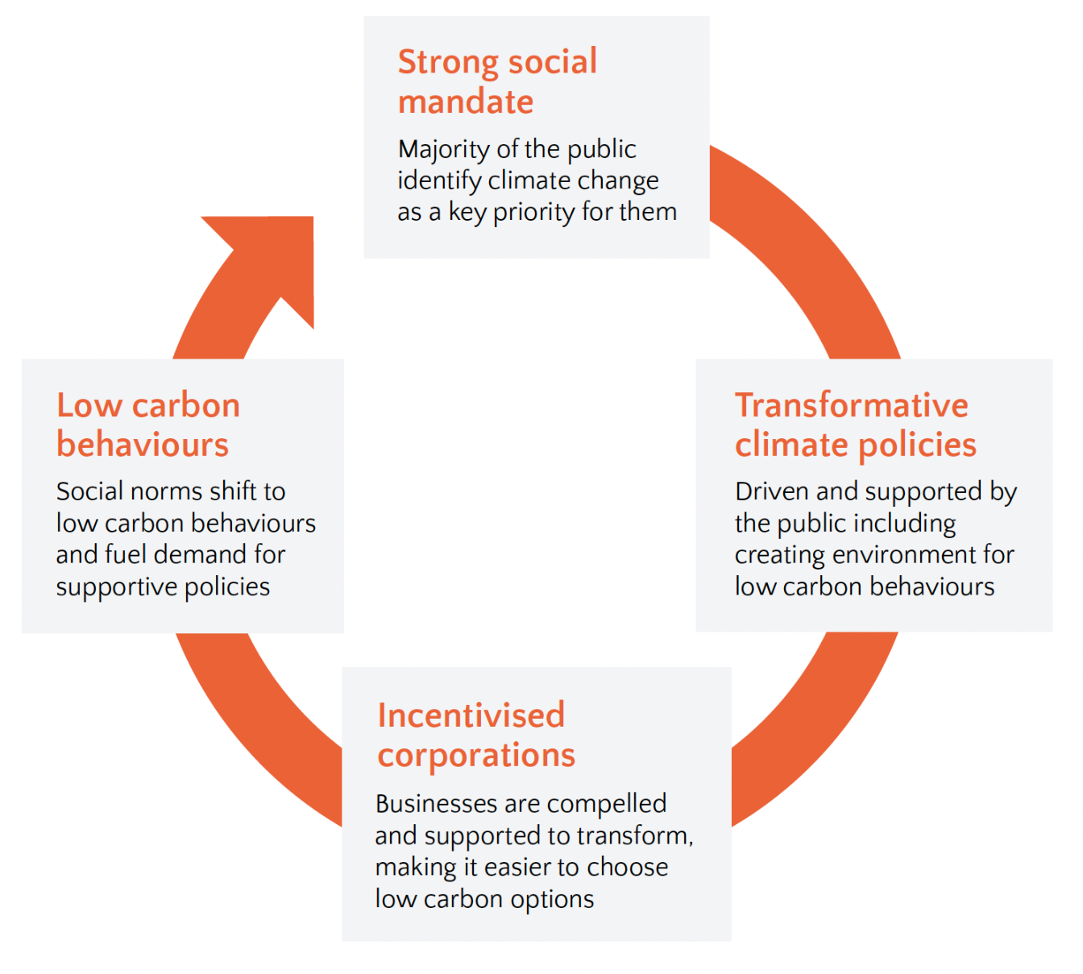
Trapped in a vicious cycle
Social mandate contributes to virtuous cycle
Lobbyists
Social Norms
Climate Outreach

Slide 7
There are many ways to make a difference in our communities and move the needle on climate
Individual Behavior
Consumer Advocacy
Political
Advocacy
Awareness
Talk
Organize

Slide 8
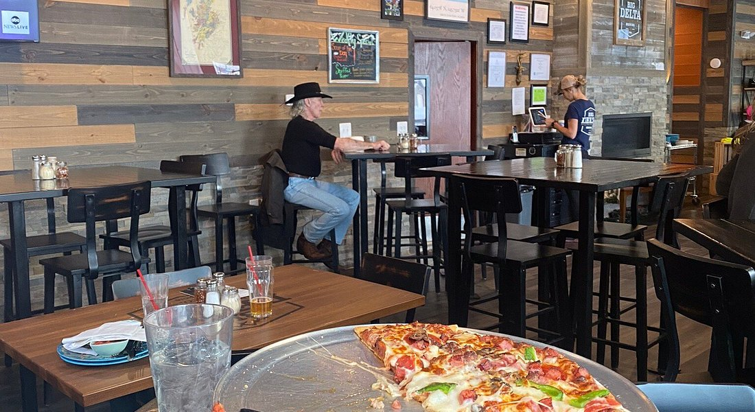
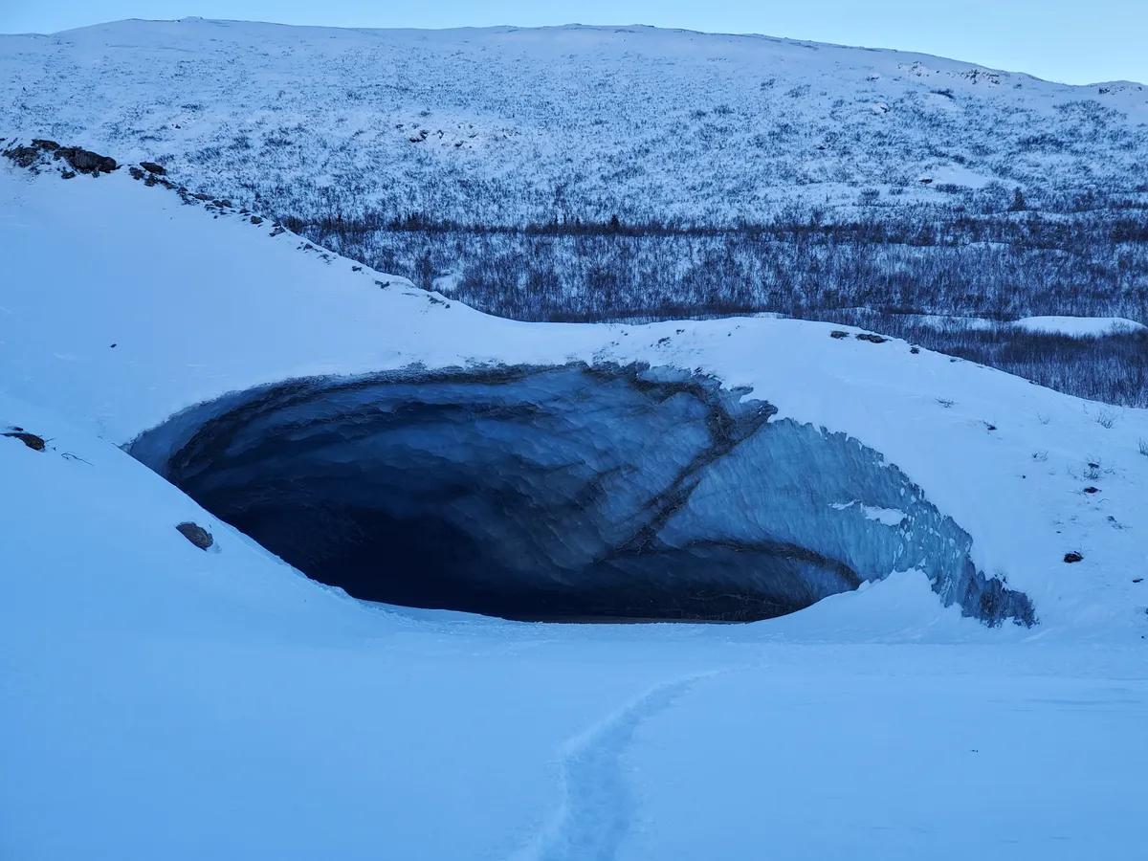
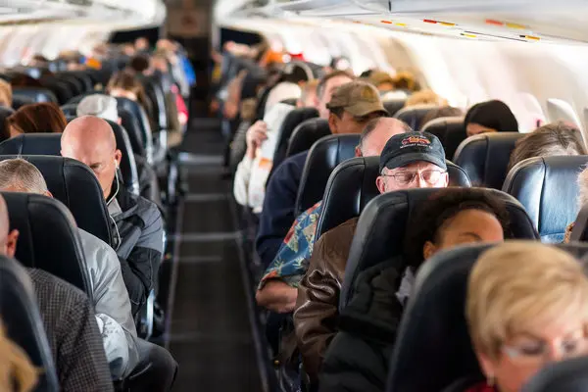
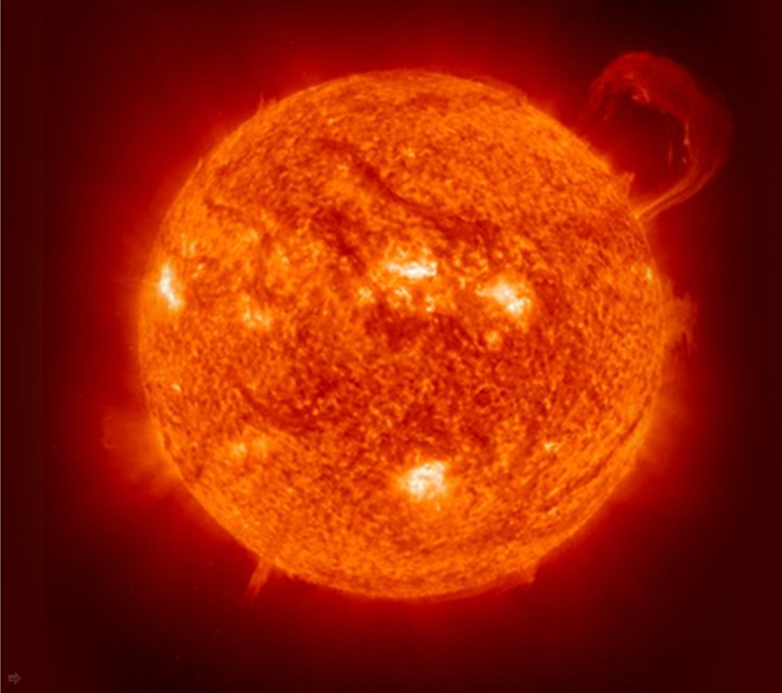
Personal stories of climate conversations
Sometimes, things don’t go quite as planned
But sometimes, conversations can make a difference

Slide 9
Dialogue Agreement
Dialogue agreement
In Every Chair, A Leader
Speak with Care for Others
Value Each Others Time
Listen Deeply
Safe Space for Meaningful Conversation
Our Value of humor
Be Present and Engaged
Take Care of Yourself, Take Care of Others
Allow Disagreements to Happen
Others?
Credit: First Alaskans Institute
Notes:
In Every Chair, A Leader Each person engaging in this conversation has a unique and valuable experience that is their truth.
Speak with Care for Others We each hold the responsibility to choose our words and questions carefully with the intent to learn.
Value Each Others Time We all share the responsibility to ensure that everyone has an opportunity to speak and engage.
Listen Deeply This is a rare and valuable opportunity to connect with others through the sharing of life experience.
Safe Space for Meaningful Conversation All notes taken are non-attribution to ensure anonymity of all dialogue participants.
Our Value of Humor Laughing is also an important way to relate with one another.
Be Present and Engaged Cell phone ringers off, be mindful of being fully present and listening.
Take Care of Yourself, Take Care of Each Other Note restrooms, exits, other amenities. Ask that participants help one another when possible.

Slide 10
Climate conversation group activity
Part 1 (5 minutes):
Write about a conversation you had about climate change. Who was there and what happened?
Part 2 (10 minutes):
Share the story of your climate conversation with your neighbors.
Part 3 (10 minutes):
As a group, using your increasing climate change knowledge, personal climate map observations, and climate communication strategies, what might have helped this conversation go better? Would you have said anything different?
Part 4 (10 minutes):
On your own, through a climate conversation you would like to have. Who is it with? What defensiveness or counterpoints might come up? How do you respond?
Notes:
In Every Chair, A Leader Each person engaging in this conversation has a unique and valuable experience that is their truth.
Speak with Care for Others We each hold the responsibility to choose our words and questions carefully with the intent to learn.
Value Each Others Time We all share the responsibility to ensure that everyone has an opportunity to speak and engage.
Listen Deeply This is a rare and valuable opportunity to connect with others through the sharing of life experience.
Safe Space for Meaningful Conversation All notes taken are non-attribution to ensure anonymity of all dialogue participants.
Our Value of Humor Laughing is also an important way to relate with one another.
Be Present and Engaged Cell phone ringers off, be mindful of being fully present and listening.
Take Care of Yourself, Take Care of Each Other Note restrooms, exits, other amenities. Ask that participants help one another when possible.

Slide 11
Climate conversation group activity
Part 1 (5 minutes):
Write about a conversation you had about climate change. Who was there and what happened?
Part 2 (10 minutes):
Share the story of your climate conversation with your neighbors.
Part 3 (10 minutes):
As a group, using your increasing climate change knowledge, personal climate map observations, and climate communication strategies, what might have helped this conversation go better? Would you have said anything different?
Part 4 (10 minutes):
On your own, through a climate conversation you would like to have. Who is it with? What defensiveness or counterpoints might come up? How do you respond?
Notes:
In Every Chair, A Leader Each person engaging in this conversation has a unique and valuable experience that is their truth.
Speak with Care for Others We each hold the responsibility to choose our words and questions carefully with the intent to learn.
Value Each Others Time We all share the responsibility to ensure that everyone has an opportunity to speak and engage.
Listen Deeply This is a rare and valuable opportunity to connect with others through the sharing of life experience.
Safe Space for Meaningful Conversation All notes taken are non-attribution to ensure anonymity of all dialogue participants.
Our Value of Humor Laughing is also an important way to relate with one another.
Be Present and Engaged Cell phone ringers off, be mindful of being fully present and listening.
Take Care of Yourself, Take Care of Each Other Note restrooms, exits, other amenities. Ask that participants help one another when possible.

Slide 12
Climate conversation group activity
Part 1 (5 minutes):
Write about a conversation you had about climate change. Who was there and what happened?
Part 2 (10 minutes):
Share the story of your climate conversation with your neighbors.
Part 3 (10 minutes):
As a group, using your increasing climate change knowledge, personal climate map observations, and climate communication strategies, what might have helped this conversation go better? Would you have said anything different?
Part 4 (10 minutes):
On your own, through a climate conversation you would like to have. Who is it with? What defensiveness or counterpoints might come up? How do you respond?
Notes:
In Every Chair, A Leader Each person engaging in this conversation has a unique and valuable experience that is their truth.
Speak with Care for Others We each hold the responsibility to choose our words and questions carefully with the intent to learn.
Value Each Others Time We all share the responsibility to ensure that everyone has an opportunity to speak and engage.
Listen Deeply This is a rare and valuable opportunity to connect with others through the sharing of life experience.
Safe Space for Meaningful Conversation All notes taken are non-attribution to ensure anonymity of all dialogue participants.
Our Value of Humor Laughing is also an important way to relate with one another.
Be Present and Engaged Cell phone ringers off, be mindful of being fully present and listening.
Take Care of Yourself, Take Care of Each Other Note restrooms, exits, other amenities. Ask that participants help one another when possible.

Slide 13
Climate conversation group activity
Part 1 (5 minutes):
Write about a conversation you had about climate change. Who was there and what happened?
Part 2 (10 minutes):
Share the story of your climate conversation with your neighbors.
Part 3 (10 minutes):
As a group, using your increasing climate change knowledge, personal climate map observations, and climate communication strategies, what might have helped this conversation go better? Would you have said anything different?
Part 4 (10 minutes):
On your own, think through a climate conversation you would like to have. Who is it with? What defensiveness or counterpoints might come up? How do you respond?
Notes:
In Every Chair, A Leader Each person engaging in this conversation has a unique and valuable experience that is their truth.
Speak with Care for Others We each hold the responsibility to choose our words and questions carefully with the intent to learn.
Value Each Others Time We all share the responsibility to ensure that everyone has an opportunity to speak and engage.
Listen Deeply This is a rare and valuable opportunity to connect with others through the sharing of life experience.
Safe Space for Meaningful Conversation All notes taken are non-attribution to ensure anonymity of all dialogue participants.
Our Value of Humor Laughing is also an important way to relate with one another.
Be Present and Engaged Cell phone ringers off, be mindful of being fully present and listening.
Take Care of Yourself, Take Care of Each Other Note restrooms, exits, other amenities. Ask that participants help one another when possible.

